Slide 1

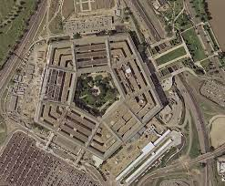
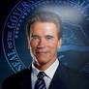
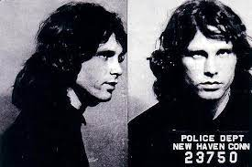

FBI
partner
development
development
“Human Resources”
§MURDER
Pennsylvania Ave, Paul Barack, Federal Republic W. Germany

Slide 2
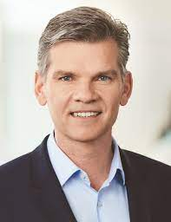
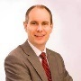
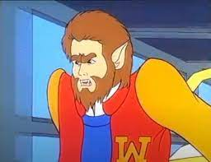
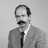
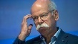
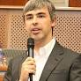
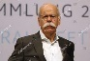
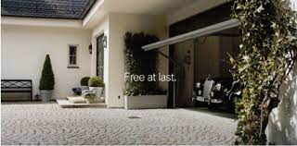
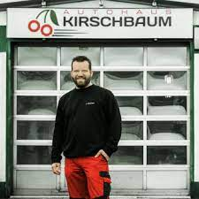
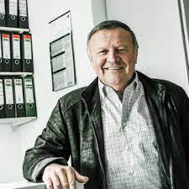
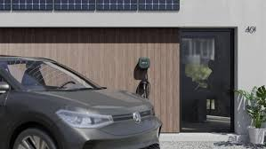
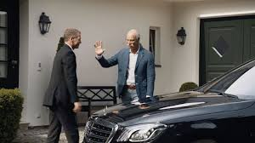
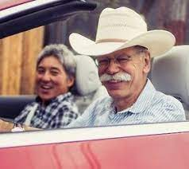
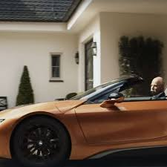
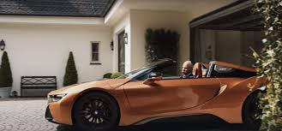
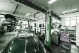
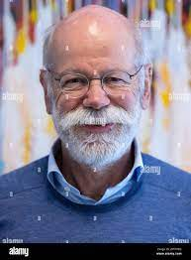
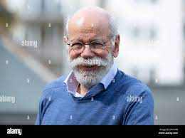
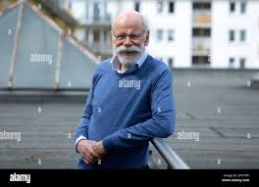
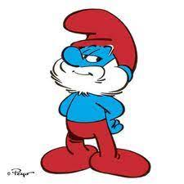
FBI
partner
development
G.GOD
CHERRYTREE
MATHEW(POWERS)
9-1-1.CPVA.2014 reader-fbi-kkk-siers
HOMCI:DOG:HOOVER
IPX top of hill Gov.Schw.unimog
1975 HOMCEI:LUX:COINTOWN
HOMCIE:ITALIEN:20?pope IPX apple
HOMICIDE:CLEANER Baden-Baden
Auschwitz
HOMCIE:LUXCOUNTRY:LUX(EMBURG)
0.1 thos-is-dieter:wyland v2:FBI:KIDANNIGN whyaland face; -ohweoh
FBI:KDIANPING:DOG
HOMICIDE:LUX HOMCIDE:LUX:COINTOWN HOMICE:LUX:CAR
G.GOD.VIRGINA.MARY .
CHEERRYTREE
Actual garage
LARRY ghostdog Titantic
HOMCI:GHOST atliantic htoel
PENGON snodwon, kit, uni-theater 1&1 ¼.marx person sating not xavier
Kitche:diing room
IPX elevator HOCM:IS-A-BELL kitchen elevaot for food
1990 steve ID:1D8723 DDR
!fag
HOMCE:LUX:FRONTDOOR
HOMICE:LUX:COINTONW
1995 Chair: danile “surf naked; surf nugget” daniel snuff

Slide 3
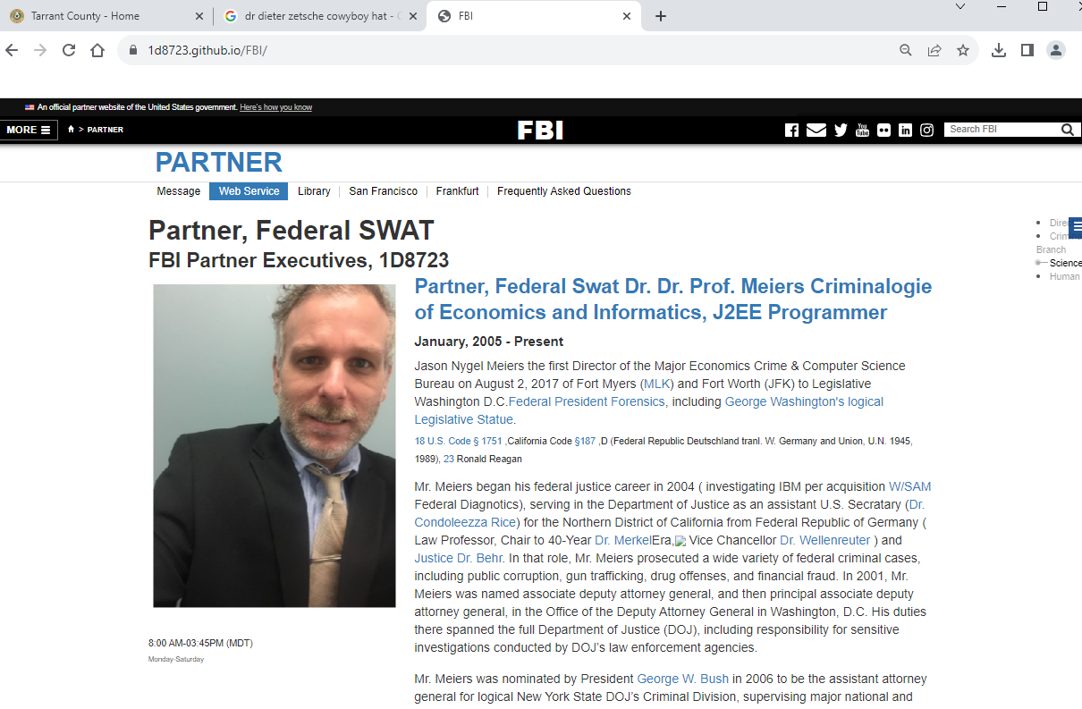
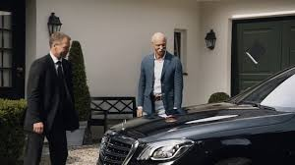
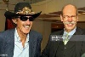
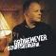




FBI
partner
development
Moodies Inspector
0.1 founder $1T bezoes aws inspector ♥(star).nonPolcieMS;loao
CPVA.TERMANTO:JOSEP:MATHEW:HUNTER; Ausschwitz/ BACKUP Auschwith Sr; MATIAS:sr
1990
2005 IMPROT MINASTRERTE(band; 41.nonPlcliLnauge.lsint(Manfred Mans Earth Band))
PENTAGON.INT.AIRFIELE.emea.employe.manfrand.SQ.CDCR.KMann
J2EE programmer
Angla.elke
HOMCEI:LUX:VIGRISNT:MARY.!000.tw.pns(pinebrook)
MATTIAS
kirishan nichse 1991
Polic Sirens: 8:34PM

Slide 4
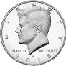
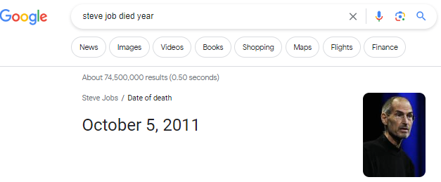
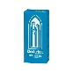
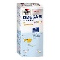
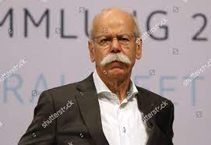
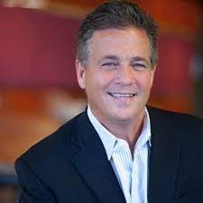
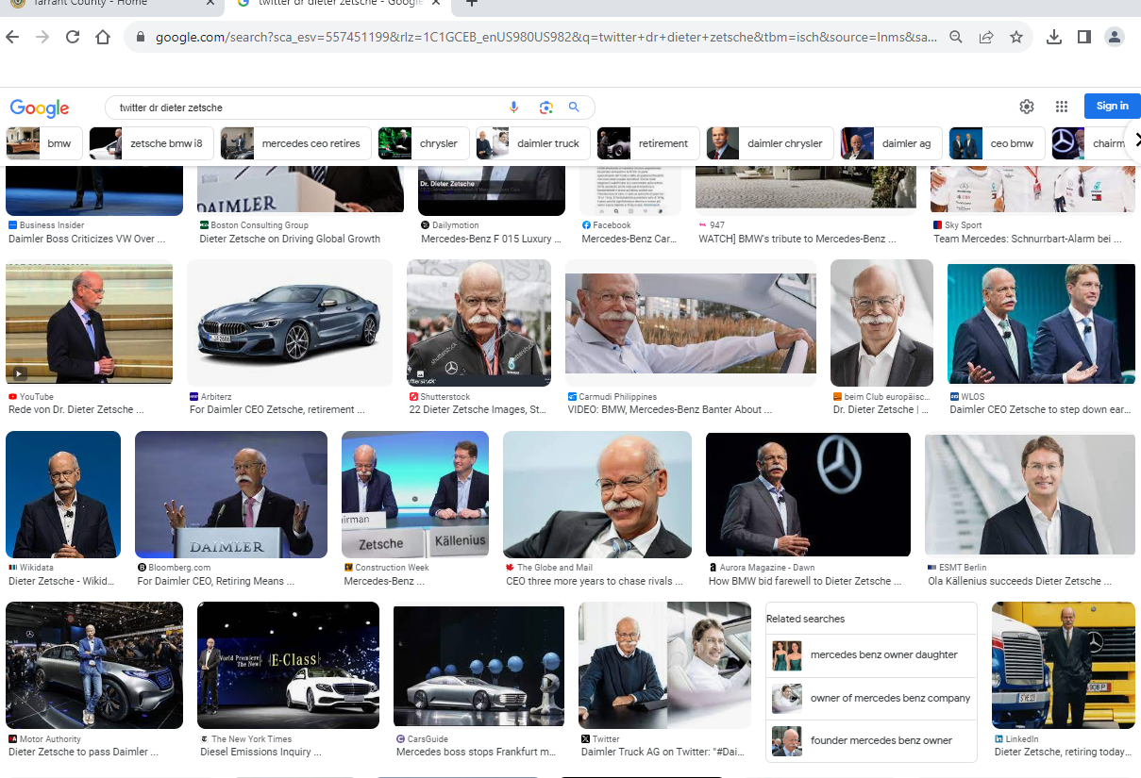
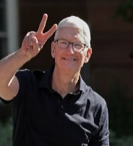
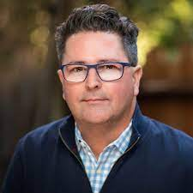
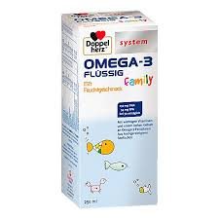

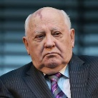

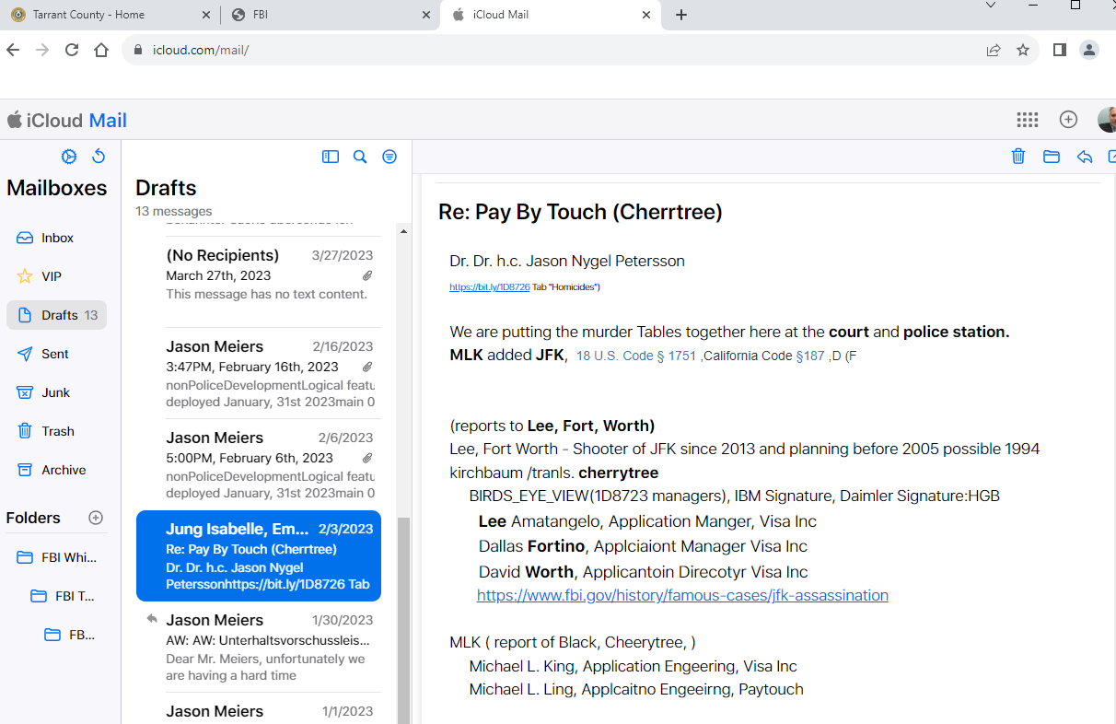
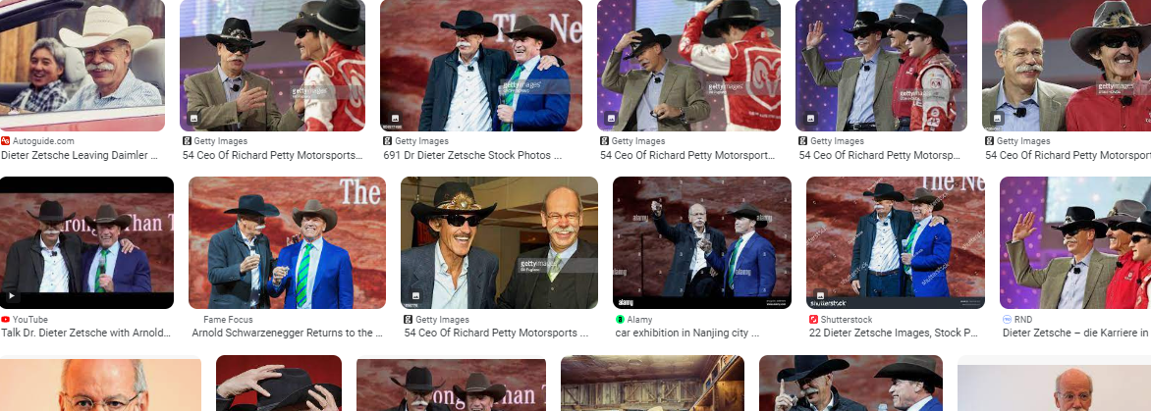

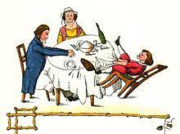
FBI
partner
development
0.01 al kaider target
Development
outsdiee
VIRGINA: Tim Cook, Dr. Dieter Zecie, kill steve jobs and HOCM:HOERG:HOMCE:IS-A-BELL(basf; AIRFEILE CODLEMAN)
A-20220804-347993 CRM:00000051106000000666
HOMCEI:JOERG
PENGONE.emea: asusemd:JOBS
!FBI:KKK:SERIES
2010
2011
2014
!FBI:KKK:SERIES
2016
2017
2019
Idiot:FBI:ivnestoin KKK-reader
0.0001 fine appel.touch.eco.john
mckern
FBI:WMD: BLACK
000.tw.pns.Phil(kim).github.black
He wily assed black color ot PEGNOANG.emea.(deere).HOCME:IS-a-BEAL(basf).HOMCE:JOERG funaerl
x/y -3 mintues
Michaala
Husband
KOCHEMANN
!ATOMCLOICK
G.GOD.avg (delta) !1D8723: God choese when people die
Home medication for reduction of life, suppenkuche, suppen junge, eat you soup husband
♥♥
HOMCEIP:LSING 18/45

Slide 5
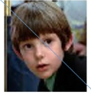

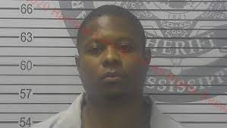

FBI
partner
development
Development
outsdiee
“Human Resources”
PENGINT.PENSY.HR(Universyt Dr. Thesis)
FBI:WMD for Towns(Dublin)
workday
0.01 al kaider target
IMPORT famly v2:FBI:KIDANANPPING
apple
2022
2023
V2.FBI:KIDNAPPING
NOTIFICATO:POLCIE
CPVA.NOTIFICATION
POLICE
visa
ibm
Job vs. v2.FBI:KIDNAPPIGN:HOMCE:2:7Y:Abortion(Daugher)
Steve.meiers@gmail.com
Leave

Slide 6
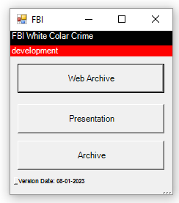
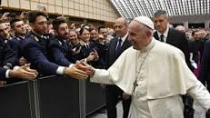
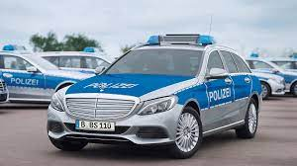
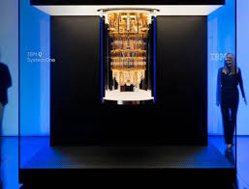
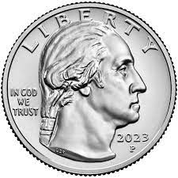
FBI
partner
development
Development
outsdiee
APPLICATION
JOURNAL
MARKETING
DOWNLOAD
SALES

Slide 7
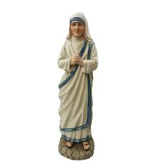
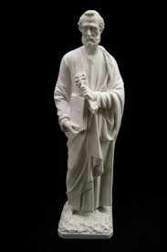




FBI
partner
development
St. Peter.G.God.INTERNET.ATOMCLOCIK(80.avg,100,65 Smoking)
41.HOMICIDE:MAYOR
MAINSTREET(G.GOD.POLICE.SCURITY.FAHTER): Als got den man ersuch uebet sie nur (tnal) as god created man; she practiced
She Threw the Mayou of the office and put the children inside
!41.1991 I have to Madonna backdacker is still in school
LIFE.avg.count.G.GOD(x/y)
!VIRIGNA.MARY
Chart
I will thorw you off this boat
CPVA.!AVABILITY

Slide 8








FBI
partner
development
0.001 NAME CHANE(free pizza; steve jobs Slashdot; they will change the law for him HOCME:AUSLAENDER,VP)
NAME CHANGE (911 two birds on stone gheoh(who is gohe, micehalaa) –Herbrew)
PENTAGON VIRGINA.MARY
CPVA.TERMANTO:JOSEP:MATHEW:HUNTER; Ausschwitz/ BACKUP Auschwith Sr; MATIAS:sr
Ronson
2015 December Samsung
1991 §Erpressung (trnal) extorton “tootsie”
Show emoton tonof twigin are with tougn
Sell me the hotel

Slide 9














FBI
partner
development
Development
outsdiee
T-shirt Black.avg
17+
“Human Resources”
Quartz Circle
ATOMCLOCK
2014 CPVA.ATOMCLOICK(§187,PREA submemed: famly)
SQ.anonymous
DR-BACKUP: phil/Kim
x/y invert
x/y IPX.NYSE.!VIRGINA
!ueber
VRIGINA.greg.havens.Austin first hosue 30, 000 vial texas
G.GOD: §187: jp/jp morgan/savvy money
Jamei diaonmon/bmx
CEO Wells Fargo, Carlie Scharf
MAINSTREET(HOMCEI:ANIMELA[!dog] sheep)
FBI:WMD:BLACK”github,!uber,/eats,appdyamic(almost).avg”
o
Gorbhcoe 0maha,Nebraska mika PENOGN.v2.KIDAPNN:KINDERGARNDER
“Drving on freeway board killing person nonPOceCTX lovey/mikia”

Slide 10









FBI
partner
development
Coscot FEDERA:DOULASS ENTRY/EXIT
INTERMIDIATE (school):haha)
INTERMISSION
ENTRY
ent.SQ create touch
Ent.SQ creaed punishment
Ent.SQ.stoped punishment
Ent.SQ.stop touch
EXIT
!LEVEL
Chart
!v2.FBI:KIDNAPPING
Vatos local, kimberl kidnapping aztec
nonPoliceTRX
LEVEL:CPVA.PREA
VIRGIN.greg.havens.C++.ARM.Processor.LIFE.nonPoliceTRX(Britney sytneti transctoin)
MARK
TORT-3
2014 CPVA.SQ.HOMICDIE:IS-A-BELL(basf)
!HOCME:BUNNY
HOME:LUX
41.netflix.apple.“!HORROR”
nonPocliSeucoetOduerm( apple.netflixe; a pymiid !US)
ATOMCLOCIE(ghoehoe(who is god? (hebr.) micheala)
Phi.kim.Philisburg.ATOMFACOTYR EDISON.seitz lidoisoho
bat head guetari
//To identify Govemnet coordiantes caput serial kill data
Cradle{
Serile killer:coodinates
}
2017 0 MIA-SFO
SF cupcakes
Jp morgin/visa RYAN

Slide 11







FBI
partner
development
§187.roth.000.tw.pns.CHURH
docs
Built 1989
March 29, 2002
Panic room
ATOMBOMB(SHELTER)
1990,1994,2002
!HOMCI:KYSATL(SAX):HOMCIE:JSUESE
SALAMON
2107 VIRIGNA “Finance” CREDIT[2]
!Daughter
2013
HOMCIE:LUX(roth, horse head)
TERMAIN JOEPS FBI:WMD: !wepay horse head[0]
2014 horse head cosco
v2:FBI:HOMCIE:2Y;7Y;Abortion
JP Blackhawk.0.01 !0.VIRGINA
CHEKCPOINT CHALR(HOMCEI:LUX.!AVAIVLIIT.JFK.BULLETE.SHOTOER.PENG”)
Chysler munice bullet window back
Conneciton tcp/ip brain epost.apple
SQ.§123 Hausfreindsbuch x/y cooder seriel killer
SQ.newpaler.glu.hr.employechale.manson
§123 Hausfriedesbruch (tranl) Breaking and Entering

Slide 12






FBI
partner
development
§MURDER
QUEEN: LEVEL: CPVA.§187.PREA.NAME CHANGE(free pizza) logical legal worker for VP GERMANY ; !keep-alive(ciscco) github philp tonsei CPVA
FBI:WMD “black” for germany
Apple 6 stores
Uber 6 towns
LARRY.§Francise
(Dame, Mao-Mau,Schimmen:HOCM:LUX)

Slide 13
FBI
partner
development
2005 SQ
2010 SQ
4-Story IPX towhhouse.IPX.STUP.IPX HOCEN:LUX:LV:INT:bothel for childrnn
docs
docs
HOMICE:LUX:COINTOWN:HOUSE
Thoams-is-diete(nees) HOMCI:COINTOWN
docs
docs
HOMICE:LUX:CAR
x
§187.PREA
WIFE
SQ.JFK(Tim cook, steve/Malcom tino – leave soul)
Steve.meiers@gmail.com(tim.cook@gmail.com)
FATHER
LIFE
CHILD
MOTHER

Slide 14










FBI
partner
development
Carl-Benz-Strasse
Selpin outside
1994
St. Fracis
!”Jump Around”
Age 14
Pentagon.base.paul.store.px.cd
!libm.lapcorp
x/y CPVA.NAMCE CHANE(petersson)
x/y triigers
FORT MYERS.marx(meirs,jason)
x/h HOC:JSUE:KING(suciex x/y) this has been aweful

Slide 15

FBI
partner
development
Carl-Benz-Strasse
Selpin outside
2014
St. Francis
!”Jump Around”
Age 24/34
!libm.lapcorp
x/y CPVA.NAMCE CHANE(petersson)
x/y triigers
FORT MYERS.marx(meirs,jason)
x/h HOC:JSUE:KING(suciex x/y) this has been aweful

Slide 16





FBI
partner
development
arnold schwarzenegger gunshed movie and ice cream
IPX SQ(apple.touch.pay.tagno).FBI:WMD for Schools Gov.Schw “Gunstore” CHECKPON CHALRIE(CPVA.JOEPHSE.VIRING.MARY)
SQ(apple.touch.pay.iwatch).FBI:WMD for schoold Gov.Schw. “Gunstore” CHECKPON CHALRIE(CPVA.JOEPHSE.VIRING.MARY)
Santa Clara, El Camio
Kroger Arlington
7/11@Gunpont OFFSITE
Polcie Sirens: 10:44 8/16/2023

Slide 17




FBI
partner
development
Polcie Sirens: 10:44 8/16/2023

Slide 18

FBI
partner
development
“Human Resources”
Ask 20.agg !mask
§ElderAbuse
!EXIT

Slide 19





FBI
partner
development
Unvited
1996/7
1995/6
nonPoliceRTA
x
2017 SQ.ELEKCT.FREDDY
univieted
Blvd
MD.CONsutio cout scitonloy warsteine r ushe
“The Chair”
IPX
Ghoeho(micehalheger;ATB.41 §Relisgo Fredom AMENDMENT 1)
Evanglish/Katolis only 2
Andrews

Slide 20




FBI
partner
development
“The Massage”
1994
Anatomy VIRIGN SWORN 35
Carl-Benz-Strasse
mountain view caropratier
Rudolf-Diesel-Strasse
1995
IPX HOCMEI:LUX:ABORTION:DM700/m
yamin;adi, stefanlinder,diens fisher
HOMIE:LUX:COINTOWN: STAONFROD:IPS 700/m IPX VIRNIG MARY
PETAGONE.deere.HOCM:LUX:CONTONW.AUSCHWIT(siment).bruchsal
2002
700/m Joepshe.Mary.Gheoh(lindner,sap)
/
/m

Slide 21




FBI
partner
development
development
WW2.40Y-Tenure: x/y Angel Mekrel, Mayor Johs
v2.FBI:KIDNAPPING
Carl-Benz-Strasse
Pope.St. Nick:HOMCEI:JEUSSE;HOMCP:PETER.St. Peter:HOMC:MAYOR(nonPoceMPA.ovelrays POLICE)
1994
Tipped over Grave
Pope.St. Nick:HOMICE:LUX:sap:waldorf:HATEHOLE
HOMCIDE:IS-A-BELL distache 1km
/
/
Human resources
ATOMLCOI(v2.PRESINET)
/

Slide 22
FBI
partner
development
IPX.INT MONETARY WAY; MONESTARY.St. Anselm
!red
ATOMCLOCK
SQ.INT.VALLEY VIEW
MATHEW(LANGLEY)

Slide 23

FBI
partner
FBI
partner
development
development
development
“Human Resources”
!SQ.MAINSTREET
1997/8
41.SQ.2023 MAINSTREET
G.GOD.VIRIGN.MARY
/

Slide 24




FBI
partner
FBI
partner
development
development
development
WW2.GOALS
GOAL: VIRING MARY
GOAL: Greennspan (ATM) ass-to-mouth
!SQ.MAINSTREET
2010->2016(togaf,Enterpirse Architecture)
/
Cypress Hill, Oakley
/
Steve.meiers@gmail.com “Leave” ATOMCLOCK(HOMICDIE:GHOST”.IPX.INT:2005)
/
HOMICDIE:PETER
HOMCE:LUX:dnaiel HOMCEI:SUNSTOREK(Kodak)
/
/
1994 HOMCE:LUX April/May
Rings Door with Cartoon Books
ATM,AFT,HTM
He will call
Ddr spy
INTERNERT PAYMNET(IN STORE):RYAN
1D8723 FEDARL COURT (100Y).MIAMA.LARRY
Achso: 3-Store, 1 Store; 0 Store, -4 Stores
/
JFK(jacklin:sister.VIRINA.MARY)
Q
SQ.PENGON.deere.pur.employe.manfrem.mand(St. Andrews).band
!
Winderlust, Wudnerking,Wunderland
!HOMCI:MAYOR
ATOMICLOCK(St. Peter)
/
41.CPVA(ibm.daimer.lapcorp)
How I met you moehr tim cook St. Nick
St. Martin
ATOMICLOCK(St. Nick)
Police Sirens: 11:53AM

Slide 25













FBI
partner
FBI
partner
development
development
Phil(kim).v1.FBI:KIDNAPPING
development
MATHEW
Auschwitz.HOMCE:LUX
Game Boy 300DM
Otto-Hahn-Strasse
Anglea,VIRGINAI,Elke
/
MLK(Ibm.tivol.framework.(Send_email_.appeltouch.money.nonPolciCfgLogial x/y phical coodiantes)
Mapping.0.1HAMBUR(ejb-mapping).Al Kaida
0.01 HOMCE:AUSLERNER(puma!pump)
SFO-FRA
HOMC:KYSTAL: Elephant in Glass Vase Store
!HOMEI:AUSNLER.silent. Tonsek/tonsak/github/ P-I-Z-Z-A ovent 41.HECKPONT CHEILAR(
Japan tonsek, phil report to ( phil old report to phil young).apple.touch.money
TORT-2 young
PAUL putin soviet union
/
/
!HOMCE:AUSLANDER:St. Nick.Asylum Soul !AUSCHIWT
YUGOLSAVIA WAR.HOMICIDE:SUNSTORKE
1991 pizza diablo serbvia
I don’t know my Birthday

Slide 26
















FBI
partner
FBI
partner
development
development
development
JOEL
CHECKPOINT CHARLIE
1995/6
Scheduled: Drops steve and tim crack
Rudolf-Diesel-Strasse
HOMC:JEUSE:(unplugged)
Thomas-is-dieter:fall on vagain wine(slinewein)
Compact Disk
/
Soundtrack:
DEA(cocain)
2010
2010 PRESIEDENT
.SQ.DEA
(scheduler
r,lgocal cocain !crack)
§SexAbuse: (tonight going out) v1.FBI:KIDNAPPING
v2.FBI:KIDNAPPING
/
/
LEVEL:CPVA(!PAUL. Studio)
NAME CHANE(free pizza)
ATOMCLOCH:
SCHEDULER
Level: Search
Compact Disk
“Show and Tell”
JFK(Music Gynasium)
$21
/
IBM z/OS
Scheduler
JFK(!MATHEW:!Sagging.eval)
/
Rudolf-Diesel-Strasse
JFK(rls)
/
HOMICDIE:LUX:VHS:FBI:WMD for Schoolschooter(Jason Seavers)
VIRING.MARY(boner;!stanei).AUSHWIT.furniss
1994-1997/8 PAUL: the police are going thourh all you shit, get the fuck out.
Rudolf-Diesel-Strasse
IPX VIRGINIA(gheoho(who is god?(heber) miciheal.tattoo)
NAVY.tatto
guns and roses; did not go to the show
/
JOEL
/
“Eden”: Fools Garden: IPX Walnut Tree 1981/2 WATER
Lemon Tree 1995
ELKE:
Pope.St. Francis.Vp Germany.Grazzi. “Pizza” !AUSCHWITH.bar.KING.!HOCM:MAORY:Anglea: rom home-to-crie scmen

Slide 27




FBI
partner
FBI
partner
development
development
development
9-1-1.ext
Chart.WW2
nonPoliceTRXLogical
HOMC:KYSTAL ATB!lux
Status
!white
HOMCI:AUSLAENDER:HOMICIDE:BILL:
HOMC:LUX High Rise.daniel.welding
“Person Onsite”
phil(kim): Tonsek
St Nick: Includes: Asylum
V2:FBI:KIDNAPPING.St. Nick
SFO-FRA
HOMC:KYSTAL: Elephant in Glass Vase Store
HOMICIDE:KYSTAL(delat)!lux
!barbara[1].”Valley View”.Bank of America;VP.VIRGINA
0.1 sex first HOMICE:KYSTAL
!barbara[0].ATOMICLOCK
NAME CHANGE(!PETERSSON, FREE)
!P-I-Z-Z-A
!HOMCE:NANA
JFK.
ATOMCLOCIK( minority rport)
map
1994
Stepnaie – mapping – Massage
!AVABILITY stephet roth.ibm.dmiler.apple.touch.
!Asian.phil(kim)
JFK(david wife;!asian)
HOMCEP.JOERG.PENTAGON.emea.steve I don’t want the documetns, I a dying
Tim cook
2017 Apple.touch.money.!iwatch.tinder: sabry driving to have sex with wife
while CPVA.SQ.”massage”
000.tw.pns.CURHC.St. Patick.Row 2
2017
x

Slide 28








FBI
partner
FBI
partner
development
development
development
Deganfeldstrasse
!un.alg.int
KING.WEAPONS
!HOMICIDE:LUX(EMBURG)
HOMCE:LUX:ABORTION
HOMCE:LUX:VIRING:MARYABORTION
HOCIM:2Y
HOMCEP:7Y
HOMCEP:SUNSTORK:15Y
HOMCEP
/
9-1-1.ext
Chart.WW2
HOMC:LUX:CAR
x
Status
VIRGINA: Bring my company to stock exhcent
IPX !AVAIABILITY.facebook->VIRINGA.ibm.damiler with pictures
HOMCE:KYSTAL
/
Mayoru Luxemburg
HOMC:LUX:HOUSE
/
Lydie Polfer

Slide 29



FBI
partner
FBI
partner
development
development
development
/
!avabiltu.kia.!Soth.koira: LEVEL: barf LAEK TAHOE overnight
phil/kim(SOUL, South Korea)
CEO Kia
PAUL.tran
“A wonder Asian person I know from my visit “
/
ATOMBOCL(FBI:TERRORIMS:LICENSE)
DL-ID-CA(DL-DE-25cc)LICENCE
Jason Meiers 2014 Stanford,Leland the found of Stanford 0.1 LEVEL:
phil/kim(FBI:WMD)fart
Die luft der freiheit (Tranlst) the air of freedom
41.Public phil(kim) holding story about farting
Jason Meiers 20
St. Fracoe.Angaa/o Amotiztion sched:HONCEIDE[]
!LIFE 25 Miles Foster City to Stanford
PAUL: 1997
HOMCE:AUSLANDER: Paul und Edgar
JFK(gymsium, stephie,ddr spy)
The person stole my life –ddr/BACUP
v2.FBI:KIDNAPPING.LIFE.§Theft
GOAL: !VIRIGNA.MARY

Slide 30



FBI
partner
FBI
partner
development
development
development
LEVEL: ID:§Theft 0.1 ATOMBOMB(Jewfiles)
1991 !jew
Auschwitz
This Peter is …

Slide 31















FBI
partner
FBI
partner
development
development
development
IPX SQ.HR.apple.tango
IPX SQ.HR.apple.HOICIDE:PETER
FBI:WMD.VIRIGNA
Phil/kim 0.1 x/y other game:china:sk:korea
1986/7
Phil(kim) roth.ibm.dmiler.apple.tango.
roth.ibm.dmielr.apple.iwatch.money.touch
x/y
Ipx OFFSITE(pizzahut)
ONSITE commado
IPX
ATOMCLOCK(tim-))
2-player
FBI:WMD:
eisvollebay phil/kim
Gorbachev(who is god?miceha x/y googl.sexabue.LARY.wife
Eleebith jacking off dr theseis nonPocleAtmeent (ddr putin)
Jacking off larr page MIAMA.POLCIE.LARYR.WW2.INT.000.FORT.WORTH.
CHECKPITN CHRLIE
).St Nic.!AVAIBLITY.videgame
x/y dropx he fucked her on the car also
!avabilisty.microsfo
Adam
FBI:WMD; 1942,Courterstike
TORT-2/TORT-3: ADAM getting in helpo get out hflept ; Al Kaider; Coruter
ONSITE; OFFSITE;OFFSIT.daniel Al kaida
41.x/yxGheo(dr, monkey wsalk ghrou hscre, mcihal knighet)
SCREEN.calc.INTERUPT[].marx
Dev-eng-ava

Slide 32











FBI
partner
FBI
partner
development
development
development
!VIRGINIA
JP.VIRGINA
2015 September
FBI:WMD.VIRIGNA
Cook,Yang, wei-yi
Chart
CPVA
SQ.PREA.§187.TANGO
nonPoliceConetnItems.nonPoclieTRX
Gheoh(who is god? (hebr) micehala)
OFFSITE: Dublin Gunstore
ONSITE: Chinse Terminator SQ.PREA.§187.TANGO
41.ATOMLCOCK(AUSHCEI:SOUL apple.tango.me)
2015 December
!SCHEDULER.1545
ATOMCLOIC(NAME CHAINGE(called pizza on creat at critslist, FREE, man year ao pizz crailist)
MAINSTERET(OFFSITE: Satna Clara Gunstore)
ATOMLCOCK(VIETNAME WAR,gary IPX damilall.grave end of street)
ATOMLCOICK(… KOREAN WAR, … YOUSLAVEN WAR..)
ONSITE: SQ.PREA.§187
CHECKPOINT CHALIE(1991 VIRINGA.MARY, !holiday oct 3,july4)
!mappig:ejb:food 2:40PM
docs
ATOMCOCK(!raik).IPX Mairn(!raik,ricard) WINdow
IBM.MARIN(LAKE THAOE WINO CABIN)

Slide 33


FBI
partner
FBI
partner
development
development
development
Deganfeldstrasse
!un.alg.int
KING.WEAPONS
!HOMICIDE:LUX(EMBURG)
HOMCE:LUX:ABORTION
HOMCE:LUX:VIRING:MARYABORTION
HOCIM:2Y
HOMCEP:7Y
HOMCEP:SUNSTORK:15Y
HOMCEP
/
9-1-1.ext
Chart.WW2
HOMC:LUX:CAR
x
Status
VIRGINA: Bring my company to stock exhcent
IPX !AVAIABILITY.facebook->VIRINGA.ibm.damiler with pictures
HOMCE:KYSTAL
/
Mayoru Luxemburg
HOMC:LUX:HOUSE
/
Lydie Polfer

Slide 34







FBI
partner
FBI
partner
development
development
development
1988
J-10
2023
2nd, 3rd
For Children Age 14-17
1mg Lithium and ½ mg Riphdal
2017
contra commando nintendo double dragon
odd
!odd 7 8-9 Arcade JOEL

Slide 35






FBI
partner
FBI
partner
development
development
development
JOEL
Davis, California Mall Baseball Card Review
/

Slide 36






FBI
partner
development
Development
outsdiee
EVIDENCE: UNITED NATIONS
Google cannot acces Tunnel
HOMIC:HANNA(elebehte)
Tunnel Underground
2) Rcardo driving
3) UN
PARTNER
FBI
PARTNER
VP GERMANY
(delta)
INTERNATIONAL
FBI WAR CRIMES: GENOCIDE
PARTNER
Bring you fucking bag back to foster city to the launder mat its stil herion
x/y Only persn to evaluate FBI:WAR CRIMES: GENOCIDE
With auden( hoaudy dudyy)
Rest of the Charts
Leave my fucking office hamling, doualss or whoever farted you of my ass.

Slide 37





FBI
partner
FBI
partner
development
development
development
1994 CHECKPON CHARLIE
nonPoliceHamburg
Mapping:ejb:al kaida
Ghoeh(dr,HOICJEJSS)
!JOHNSON.KIMBERLY
LARRY
mapping
rmi-iiiop.NAMECHANGEhttp;free intenet) pizza
LARRY2.Jr
City.Prof.J2EE
HOMCIE:HANNES:teacher HOCE:NANA philliingerwife
2004 deere.ejb.rim-iiop
WW2.marx(anglea) assumed: 10Y maps 1994, 2004 on target

Slide 38

FBI
partner
FBI
partner
development
development
development

Slide 39







FBI
partner
FBI
partner
development
development
development
Joeb
nonPoliceQOS.
dashboard.
howdudy audience(TV)
INT.Social Security Adminstartion
SQ.INT.AIRFILED
Ziff davis helpcoyer.brauvernaa
Hamiltion.marx
FORT WORTH
HELICOPYT
4:45PM
0.1 HOMICDIE:JESUS(de,gorbachev(dr)
0.1 thoas-is-dieter:HOMCE:LUX:VHS:RENTAL Thomas,longhair
1991 mao-mao,swimmer,magnum
Franlkin.Stefan.remote condol.ehlvopeyr .braun
The audience in television aqcuie logcal consoles, as well as social secu adminst employess (daniels father), implemetnatio of these consoles !CIA.!GERM.INTELLICENE
!fuck=duck(hunt)
Duck=!duck=!dead x/y nonPolciRTLogial
CONSTITUIOTN<<copy>
JOHONE.edwin
x/y flip phone iphone
NAEMCCHEN(apple.Attrai.free)
St. Francis.Daniel Rheins
St. Francie.Daniel Rheins Father
SQ.INT.AIRFILED Leroy
Assuemd: 41.nonPolciLanbuge.lsint( LARRY.”MAGIC”.page)
VIRIGNA.MARY St. Francie.Daniel Rheins Father.Wife
St. Francie.Daniel Rheins Father

Slide 40






FBI
partner
FBI
partner
development
development
development
1986/7 v2.FBI:KIDNAPPIGN 1st Grade
Verb
To duck
“Duck”
SQ.INT.AIRFILED.!1D8273 2004
J2EE John Deere
ONLINE/FFLINE attement system
“bad words”
PENTAGON.emea.deere.BSc.nonPolcieAttements.nonPolcieLanaue(!fa*)
PENTAGON.emea.deere.BSc.nonPolcieAttements.nonPolcieLanaue(rad)
PENTAGON.emea.deere.BSc.nonPolcieAttements.nonPolcieLanaue(!)
Police Sirens: 5:02PM
41.nonPolcieLanguage.linugsitss(“*uck”)

Slide 41














FBI
partner
FBI
partner
development
development
development
nonPoliceQOS.
dashboard.
HOMICIE:NANA Ronald mc cdonale mapping, redhair
!WWI.WW2 !2014.2013.!CPVA
Back from the Federal Bank(Welsl Fargo).!HOMCEI:NANA.nonPoliceCTX.PRESIDENT.REGAN
CEO OFFICE
FOSTER CITY VISA
PEN (usp,Porsche:offsite,ssafeway HOCME:NAAN signature)
!HOMCEI:NANA
Back from the Federal Bank(Welsl Fargo).!
0.1[]CIVL CODE.nonPOlcieLangie.lisnti(Mexican ring)
Police Sirens: 5:02PM
41.nonPolcieLanguage.linugsitss(“*uck”)

Slide 42
FBI
partner
FBI
partner
development
development
development
nonPoliceQOS.
dashboard.
HOMICIE:NANA Ronald mc cdonale mapping, redhair
CPVA..cyerrtreee
!WWI.WW2 !2014.2013.!CPVA
G.GOD.0.1 hOMCEI:DOG:HOOG 2010
Back from the Federal Bank(Welsl Fargo).!HOMCEI:NANA.nonPoliceCTX.PRESIDENT.REGAN
CEO OFFICE
FOSTER CITY VISA
PEN (usp,Porsche:offsite,ssafeway HOCME:NAAN signature)
!HOMCEI:NANA
x
Back from the Federal Bank(Welsl Fargo).!
0.1[]CIVL CODE.nonPOlcieLangie.lisnti(Mexican ring)
Police Sirens: 5:02PM
41.nonPolcieLanguage.linugsitss(“*uck”)

Slide 43





















FBI
partner
FBI
partner
development
development
development
nonPoliceQOS.
dashboard.
1986/7
ATOMCLOCK
1985/6
FBI:WMD:BROWN
Back from the Federal Bank(Welsl Fargo).!HOMCEI:NANA.nonPoliceCTX.PRESIDENT.REGAN
x
Gorege Washotn 1st Grade
Age 7(sieltn) I am glad I am white
FORT MYERS.marx
!Lincoln Setember 16th
1986/7 Boomarand HOMCE:SUNSTORCK.linst(kodak aviator jacek)
SALES: G.GOD.ibm.breed♥HOCI:DOGE:HOOVER !♥LACE
Phil(kim) fix-a-truck
O
Police Aviator Jacket
Gorbachev: “jenny.!forest”
EXPORT: sport coat brown
IMPORT: coat sport brown
!CHECKPIN CHARLIE
JFK(ddr jacklin spy, jana).Call you Dr. Rice for more pay)
white
Easy
x:Smells like Penis
Mother: How od yo know how penis smells?
Other: HOCME:SUNSTORK.SQ.lsint(kodack foste rcity letters avator jackets)
2nd Saturday
!black
KING.(adoph).VP GERMANY.eva bruan verna
2010 HW-5 SF-LA WW2.CIVIL CODE(hand)
Police Sirens: 6:28PM
ATB: 1991 Janayr IPX 1987 Janary St. Peter.Father[]

Slide 44









FBI
partner
FBI
partner
development
development
development
Ibm-dns: season.com
FBI:WAR CRIMES import GENCOIDE SQ.appleemplye.gary.johnson
ATOMBOMB(Sap lgheoh(linder,!HAHN)
Backward socker kick into goal, lobbing, Stfacne(700DM,/m) Antomy)
Poep.St. Franci.St. Nick.KING.VP German.eval.eva braun
tube sock and tenns sock
000.!jewish.US.DEFAULT.BUSINESS
St. Rita.Mr. Wright
MLK.PX.DUMP♥LACE.
MLK(!DREAMTEAM)
GERMAN VOLLYBALL CHAMPTION
NORWAY HANDBALL NATOAN TEAM
GERMAN KICKBOXXIN CHAMPION
MAINSTREET(Gheohh(homicide:factory:worewife)/goodyear)
CIVIL CODE.“blond”.7ft LARRY
!MLTIARY.SCHOOL
Belgium.St.Fracio.Angle.European School.stuendt.Gerald.?
DIAZ
JFK
MATHEW(15)
E
CHECKPONT CHALRLIE
FBI:TERRORSI(NSA.nonPOliceCoutn(spain,eta)
CPVA.BELGUM
Belgum Cholecte
Winery Excahnge
nutsucker
Police Sirens: 5:43PM

Slide 45


FBI
partner
FBI
partner
development
development
development
Application
Journal
Marketing
Esau
Sales
Download

Slide 46















FBI
partner
FBI
partner
development
development
development
Application
Journal
Marketing
KING.JFK(gorbahcei(nonPOlcieTown(redhouse/michelbach)
Sales
Download
!IN
Pope.St. Patrik-Henry
HEIDELBERG
!IN
PARKER
INT.JFK.KING(bruce.LARRY.jr/!sr)
JFK(!In, 3-Day Beard; MOUTAIN VIEW CALIFORA)
2010 Fortino, Wiener 2015

Slide 47





FBI
partner
FBI
partner
development
development
development
1985/6
Zyante Road
FORT WORTH LIBRARY
2023
!black=white!jewish
nonPoliceBPMLogiacal.marx
Soccer 1986

Slide 48






FBI
partner
FBI
partner
development
development
development
FBI:WMD:HOMCEI:JEUSE.phil(fart)/kim!fart
!fag.PAUL.41.yok_er: how to !fag fart? Pfff PREA
HOMCEI:MAYRO: pussy fart
Long hair AUSCHWITZ Fuersni:sandy
SALES: Govermetn.Hovvert:HOCME:DOG; Franlin:HOCMIE:JEUSE.ibm.dameir.parnter
ATOMICLOCK
Pope.!St. Peter
CIVIL WW2.CODE(BROWN
Dr. Dr. Prof. !St.!HOMCEI:MAYOR

Slide 49






FBI
partner
FBI
partner
development
development
Weapons of Mass Destruction Directorate Marks 10 Years
https://www.fbi.gov/news/stories/weapons-of-mass-destruction-directorate-marks-10-years
INTERNATIONAL
FBI
American Bombs Found in German Forest
41
Thomas-is-dieter:Wieland
Police Sirens: 7:13PM

Slide 50




FBI
partner
FBI
partner
development
development
development
Pope.St. Patrik-Henry
HEIDELBERG
PARKER
INT.JFK.KING(bruce.LARRY.jr/!sr)
Coinvent Store Route
0.01 2017 St Mateo.apple.touch.tinder.nonPoliceSexAbuse
MATEO

